Slide 1
Cell2Cell-
Part 1
Team M: Amishi Sachdeva, Anoop Kaur, Dakshta Mehta, Krithika Jagannath, Saanika Shahi

Slide 2
Table of contents
01
02
03
04
05
06
Purpose
Decision Tree
Logistic Regression
Best Model
Suggested Offer
Appendix

Slide 3
01
Purpose

Slide 4

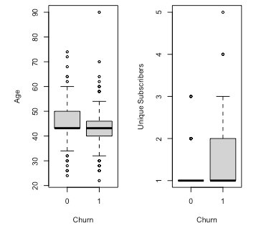
Purpose
By developing a predictive churn model and identifying the key drivers of churn, Cell2Cell can target at-risk customers with tailored offers to retain them. This approach will help Cell2Cell with a data-driven, proactive strategy, thus; improving customer satisfaction and long-term profitability. The following are the 3 relationships between churn and predicted variables:
Variable | Relationship with Churn | Evidence
Retcall (Call to retention team) | If a customer has made a call to the retention team, the probability of churning is higher, as we can see the number of customers who churn is double.
Uniqsubs (No. of Unique Subscribers) | If number of unique subscribers increases, the churn rate is likely to increase.
Age (Age of first household member) | If a customer’s age increases, the customer is likely to stay and a young customer is likely to churn.
Notes:
We cross-tabulated all categorical predicted variables with churn and constructed boxplots of all continuous variables with churn. We examined both the tabulations and the plots but there was not any significant variation in the churn group vs. the non-churn group. Although we have added all the boxplots in the appendix as well for reference.

Slide 5
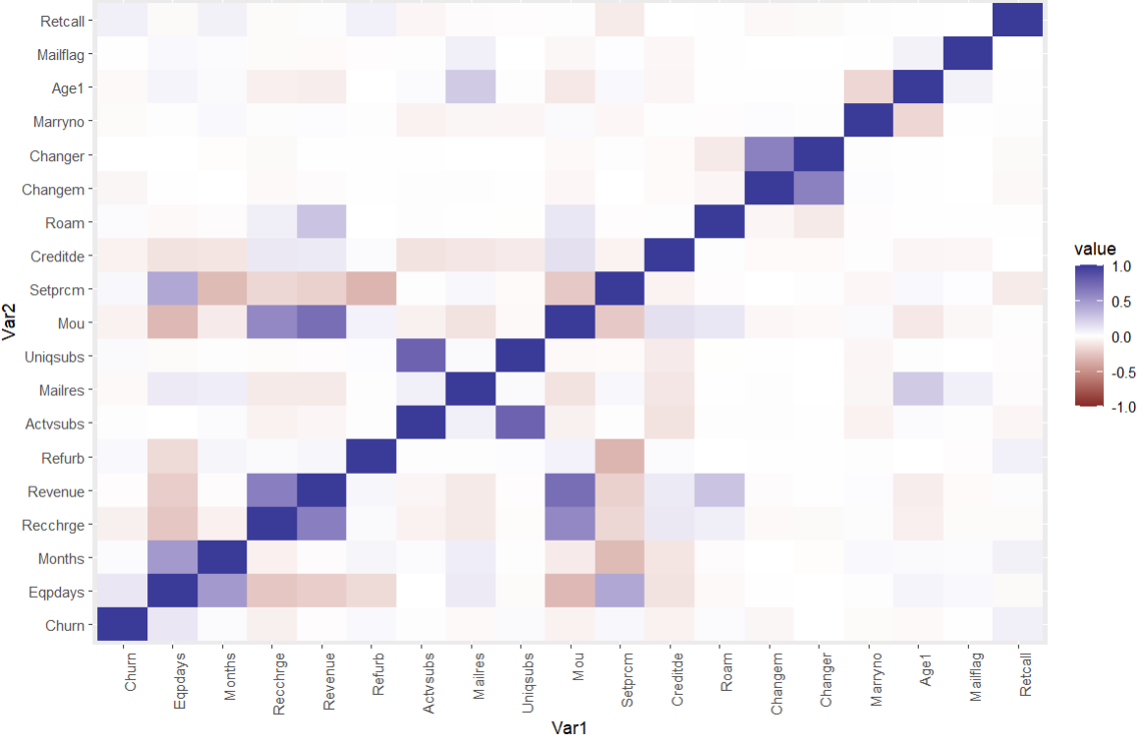
Feature Selection
- After analyzing the data, we have decided to move forwards with these selected features:
Eqpdays, Months, Recchrge, Revenue, Csa, Refurb, Actvsubs, Mailres, Uniqsubs, Mou,Setprcm,Creditde,Roam,Changem,Changer,Marryno, Age1,Mailflag,Retcall
- We meticulously chose these features by analyzing the correlation matrix and studying scatter plots to comprehend their relationship with the target variable.
- These features aid in uncovering underlying patterns within the data and are instrumental in producing accurate results, facilitating us in targeting the appropriate audience.
Notes:
We cross-tabulated all categorical predicted variables with churn and constructed boxplots of all continuous variables with churn. We examined both the tabulations and the plots but there was not any significant variation in the churn group vs. the non-churn group. Although we have added all the boxplots in the appendix as well for reference.

Slide 6
02
Decision Tree

Slide 7
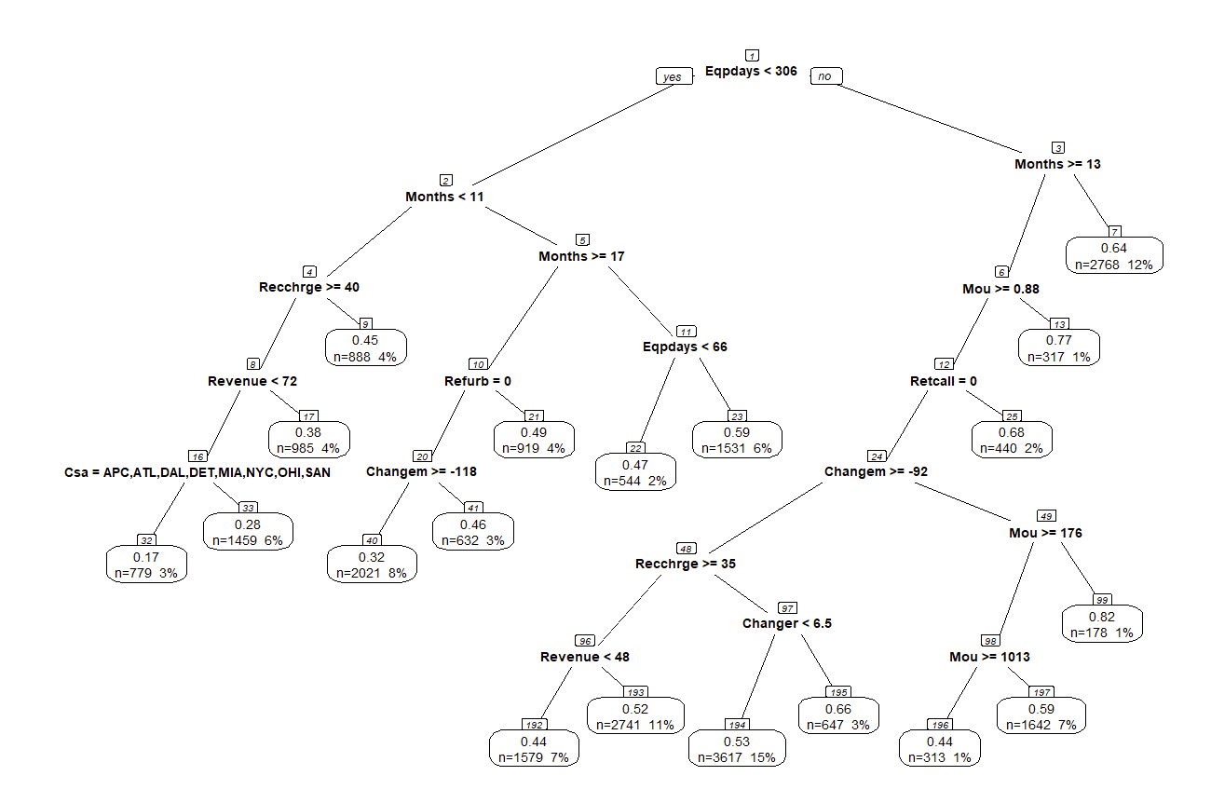
Decision Tree: Churn Probabilities & Key Customer Insights
Churn Rate | Explanation | Detailed Explanation
12% | With a 0.64 probability of churn, 12% of customers, or 2,768 individuals who have newer devices and a subscription of over a year, are at risk of leaving. | This segment belongs to the individuals who have been using their current equipment for less than 306 days (indicating newer devices) and have been subscribers for at least 13 months, there's a 64% chance they might churn.
Note: We chose to focus on top 4 groups from which we can maximize the probability churn rate and number of customers under that leaf node.
* Detailed explanation in the notes section
Notes:
For 12% churn rate, Based on the decision tree, the analysis indicates a significant churn probability within a specific customer segment. For individuals who have been using their current equipment for less than 306 days (indicating newer devices) and have been subscribers for at least 13 months, there's a 64% chance they might churn. This segment represents 12% of the total sample size or 2,768 customers.

Slide 8
Churn Rate | Explanation | Detailed Explanation
15% | There is a 0.53 probability that 15% of the customer base, translating to 3,617 individuals with new devices and over a year’s loyalty, might churn. | These customers are characterized by having relatively new equipment (less than 306 days old) and a longer relationship with the service provider (13 or more months). They engage with the service to a significant extent, as indicated by their mean monthly usage (mou) of 0.88 or higher. However, they have not engaged with the retention team (retcall = 0), despite a moderate decline in their usage (changem ≥ -92%) and experiencing minimal changes in their revenue contributions (changer < 6.5%), all while shouldering a substantial recurring charge (recchrge ≥ $35). This suggests a scenario where customers who are not brand new, yet have not formed a lasting loyalty, might feel their expectations in terms of service and cost are not being met, pushing them towards considering alternative providers.
11% | An 11% segment of the customer pool, which amounts to 2,741 individuals with recent equipment upgrades and more than a year of service, faces a 0.52 probability of churning. | This segment belongs to customers who have newer equipment (less than 306 days old) and have been subscribers for more than a year (13+ months). Being moderately active (with a mean monthly usage of 0.88 or more) they have not reached out for support (no retention calls),despite facing significant monthly charges (at least $35) against a backdrop of less than expected revenue (under $48). This pattern suggests a disconnection where, despite considerable use and recent equipment updates, the perceived value doesn't align with the cost, leading to customer turnover.
7% | A group representing 7% of customers, equaling 1,579 individuals who are well into their service contract with newer devices, have a 0.44 churn probability. | These customers have been using their equipment for less than 306 days, suggesting they have relatively new devices. They have been with the service for over a year (13+ months) and show significant usage levels (mou ≥ 0.88), yet they haven’t initiated contact with the retention team (retcall = 0), despite experiencing a considerable decrease in usage (changem ≥ -92%). This group also faces higher recurring charges (recchrge ≥ $35) while generating lower revenue (revenue < $48), which could indicate that they do not perceive enough value in the services received relative to the costs incurred, leading to their higher likelihood of churning.
Notes:
For 15% churn rate, Within the customer base, there is a segment with a 53% likelihood of churning, which comprises 15% of the total sample, or 3,617 customers. These customers are characterized by having relatively new equipment (less than 306 days old) and a longer relationship with the service provider (13 or more months). They engage with the service to a significant extent, as indicated by their mean monthly usage (mou) of 0.88 or higher. However, they have not engaged with the retention team (retcall = 0), despite a moderate decline in their usage (changem ≥ -92%) and experiencing minimal changes in their revenue contributions (changer < 6.5%), all while shouldering a substantial recurring charge (recchrge ≥ $35). This suggests a scenario where customers who are not brand new, yet have not formed a lasting loyalty, might feel their expectations in terms of service and cost are not being met, pushing them towards considering alternative providers.
For 11% churn rate, In the dataset, a 52% chance of churn is identified for 11% of the customers, totaling 2,741 individuals, who have newer equipment (less than 306 days old) and have been subscribers for more than a year (13+ months). These users are moderately active (with a mean monthly usage of 0.88 or more) but have not reached out for support (no retention calls), even as they face significant monthly charges (at least $35) against a backdrop of less than expected revenue (under $48). This pattern suggests a disconnection where, despite considerable use and recent equipment updates, the perceived value doesn't align with the cost, leading to customer turnover.
For 7% churn rate, Based on the decision tree path and given variables, there is a 44% probability that 7% of the customer segment, or 1,579 individuals from the total sample, will churn. These customers have been using their equipment for less than 306 days, suggesting they have relatively new devices. They have been with the service for over a year (13+ months) and show significant usage levels (mou ≥ 0.88), yet they haven’t initiated contact with the retention team (retcall = 0), despite experiencing a considerable decrease in usage (changem ≥ -92%). This group also faces higher recurring charges (recchrge ≥ $35) while generating lower revenue (revenue < $48), which could indicate that they do not perceive enough value in the services received relative to the costs incurred, leading to their higher likelihood of churning.

Slide 9
03
Logistic Regression

Slide 10
Features of Logistic Regression
Variable | Parameter Estimate | Meaning | Importance
Call to Retention Team (Retcall) | 0.734 | If a customer has made a call to the retention team, the odds of churning are as high as 108%. | HIGH This suggests that customers who contact the retention team are more than twice as likely to cancel their service, highlighting the critical need for effective retention strategies during these interactions.
Refurbished Handset (Refurb) | 0.293 | For every handset refurbished, the probability that a customer will churn is 34%. | HIGH Indicates a possible dissatisfaction with refurbished phones.
Missing Data on Handset Price (Setprcm) | -0.249 | For one unit change in the missing data on handset price, the churn rate decreases by 22% | HIGH Incomplete information on handset prices may be linked to lower customer turnover, which could influence data management and transparency policies.
Number of Unique Subscribers (Uniqsubs) | 0.195 | For every unique subscriber, there will be a 21.6% increase in the customer churn rate. | HIGH As the customer base grows, the risk of customers leaving the service increases significantly, which could impact long-term revenue and growth sustainability.
Detailed explanation in the appendix
Notes:
In column 3 (meaning), to calculate what are the odds of a customer churning for a particular variable, we have used Odds Ratio to calculate the % change: Formula is (Exp(Coef)-1)*100

Slide 11
Features of Logistic Regression
Variable | Parameter Estimate | Meaning | Importance
Low Credit Rating - de (Creditde) | -0.234 | For one unit change in the low credit rating - de, the churn rate decreases by 20.9% | HIGH Suggests customers with lower credit ratings are less likely to cancel their services, possibly due to fewer alternative options.
Responds to Mail Offers (Mailres) | -0.184 | For every response to the mail offer, the churn rate decreases by 16.8% | HIGH Highlights the effectiveness of mail offers in retaining customers.
Number of Active Subscribers (Actvsubs) | -0.183 | For one unit change in the number of active subs, the churn rate decreases by 16.7% | MEDIUM Highlights the importance of encouraging customers to maintain multiple subscriptions.
Not Married (Marryno) | -0.162 | For one unit change in the not married people, the churn rate decreases by 15% | MEDIUM Emphasizes the value of targeting or tailoring services to unmarried individuals to reduce churn.
Number of days of current equipment (Edpdays) | 0.002 | For every extra month (30 days), a customer's odds of churning versus not churning goes up by 8%. | MEDIUM Underscores the need for ongoing engagement and retention efforts over time.
Detailed explanation in the appendix
Notes:
Please note: all features with low importance have been attached in the appendix for reference.

Slide 12
04
Comparison of Algorithms

Slide 13


Algorithm Comparison
Logistic Regression | True Class
Predicted Class |  | 0 | 1
 | 0 | 3212 | 2859
 | 1 | 703 | 1226
Decision Tree | True Class
Predicted Class |  | 0 | 1
 | 0 | 2968 | 2505
 | 1 | 947 | 1582
Logistic Regression
- Precision = 0.636 and Recall = 0.3. Also, AUC= 0.6108 and Lift = 1.337
- We considered threshold as 0.57 to maximize precision.
- Hyperparameter max iteration as 500
Decision Tree
- Precision = 0.626, Recall= 0.3872, AUC = 0.639, Lift = 1.285
- Threshold used is 0.57 to maximize precision.
- Hyperparameters used were cp=0.0005 with minsplit = 20
We computed Precision and recall from the confusion matrix above and based on the observed values, Decision Tree demonstrates higher recall than Logistic Regression. However, Logistic Regression exhibits significantly higher precision than Decision Tree. For us, as Cell2Cell firm, who will spend a lot on marketing to make sure the customers don’t churn, so we need to determine which evaluation metric should be given precedence. So for us, preventing customer churn is a priority, warranting a focus on identifying definitive churners rather than casting a wider net. Consequently, an algorithm with higher precision, such as Logistic Regression in this instance, proves advantageous.
* Detailed explanation about precision-driven approach in the notes section
Notes:
From a precision point of view, targeting definitive churners allows businesses to allocate resources more efficiently and effectively. Precision-focused strategies enable organizations to identify customers who are most likely to churn with a high degree of accuracy, minimizing the risk of misdirected efforts.
By concentrating efforts on definitive churners, businesses can implement tailored retention tactics that address the specific needs and concerns driving their potential departure. This targeted approach increases the likelihood of successful retention interventions, as resources are directed towards customers who are most receptive to engagement.
Furthermore, focusing on precision in churn prediction enables businesses to optimize their marketing initiatives and retention campaigns. By identifying definitive churners, organizations can develop personalized offers, incentives, and communications that resonate with these customers, increasing the probability of retention and loyalty.
Ultimately, precision-driven strategies not only enhance the effectiveness of retention efforts but also contribute to improved customer satisfaction and loyalty. By prioritizing precision in churn prediction and targeting, businesses can maximize the impact of their retention initiatives, driving long-term profitability and sustainable growth.

Slide 14
Logistic Regression
Other reasons to proceed with Logistic Regression are-
Interpretability: Logistic Regression is more interpretable, which would be required in this case as customers may ask for justification as to why certain people received a promotional offer and they did not.
Avoiding Overfitting: Decision Trees are prone to overfitting, especially when the tree grows too large and captures noise in the data. Logistic Regression, with its linear decision boundary, is less prone to overfitting, making it more robust when dealing with noisy or complex datasets.
Performance in Imbalanced Datasets: Logistic Regression can handle class imbalance more effectively compared to Decision Trees. Techniques like class weighting or cost-sensitive learning can be easily implemented in Logistic Regression to address class imbalance issues.
Logistic regression provides the output as probability which helps us in tailoring for specific threshold and be more specific on which particular customers we want to target.
There are several factors where Decision tree performs better than Logistic Regression in terms of capturing complex, nonlinear relationships between predictors and outcomes, making them suitable for datasets with intricate decision boundaries or interactions among predictors. Based on our efforts to handle outliers during data preprocessing and the desire for a scalable model without overfitting concerns, we recommend proceeding with Logistic Regression over Decision Tree for determining the churn rate.

Slide 15
05
Suggested Offer

Slide 16
Churn Probability and Proactive Offer Strategies
Row Number | Logistic Regression Churn Probability | Churn Yes/No (Threshold 0.57) | Proactive Offer | Expected Impact on Churn
8695 | 0.7321 | Yes | Offer a basic plan with a lower monthly charge and loyalty program with exclusive benefits or discounts on their next purchase. The goal is to incentivize them to stay with the company. | Churn probability may decrease as the user receives a plan that better matches their low usage. The company can increase customer satisfaction and reduce the likelihood of them leaving.
15747 | 0.7951 | Yes | Adjust the plan to better fit the user’s usage pattern along with loyalty program with exclusive benefits or discounts on their next purchase. The goal is to incentivize them to stay with the company. | Churn probability may decrease if the plan is perceived as more suitable for the user’s actual usage. The company can increase customer satisfaction and reduce the likelihood of them leaving.
* Detailed explanation in the notes section
Notes:
Row 8695:
According to the data provided, user 8695 displays minimal usage with only 1.25 minutes of use and no additional charges or changes in their usage pattern. This user's low engagement suggests they might not require a comprehensive plan, leading us to offer a more basic and cost-effective plan that aligns with their low usage. This proactive strategy is tailored to retain a customer who might not be fully utilizing their current plan's features and could be seeking a more economical option. Row 15747:
User 15747 has a higher revenue contribution with 228.75 minutes of use. While the exact previous usage and roaming charges are not specified in the data we have, the proactive offer for this user would be based on any observable indicators of dissatisfaction or potential overage, as suggested by the data. An appropriate offer could be a plan with a better fit for their usage pattern, possibly with more minutes or features that match their needs to enhance satisfaction and reduce churn probability.

Slide 17
Row Number | Logistic Regression Churn Probability | Churn Yes/No (Threshold 0.58) | Proactive Offer | Offer Impact Hypothesis
29301 | 0.2764 | No | Suggest personalized product recommendations or a referral program where they can earn rewards for bringing in new customers. The idea is to reinforce their loyalty and engagement with the company. | The pro-active offer may not have a significant impact on their probability of churn. These users are already less likely to churn, so the offer could reinforce their loyalty but may not drastically change their behavior.
34573 | 0.2622 | No | Suggest an upgrade to a plan with higher usage limits to avoid overage charges along with personalized product recommendations or a referral program where they can earn rewards for bringing in new customers. The idea is to reinforce their loyalty and engagement with the company. | The pro-active offer may not have a significant impact on their probability of churn. These users are already less likely to churn, so the offer could reinforce their loyalty but may not drastically change their behavior.
Each proactive offer is tailored to the user's specific situation based on their usage patterns and charges incurred, aiming to enhance their satisfaction with the service and reduce the likelihood of churn.
* Detailed explanation in the notes section
Notes:
Row 29301:
User 29301 has a significant amount of usage at 608.25 minutes and an overage charge of 3.75, indicating they have exceeded their plan's allowance. This scenario typically warrants an offer to increase the plan's minutes, which could prevent overage charges in the future and potentially decrease churn. This user might benefit from a plan that provides a larger number of minutes or even unlimited calling to accommodate their high usage levels. Row 34573:
User 34573 shows a considerable amount of use at 360.50 minutes and a notable overage charge of 58.25. This suggests that their current plan may not align well with their usage needs, possibly leading to frequent overage charges. The proactive offer in this case would be to recommend an upgrade to a plan with a higher usage limit to prevent these overage charges. This kind of offer could make the user feel more valued and less likely to churn, as their needs are being anticipated and met.

Slide 18
06
Appendix

Slide 19
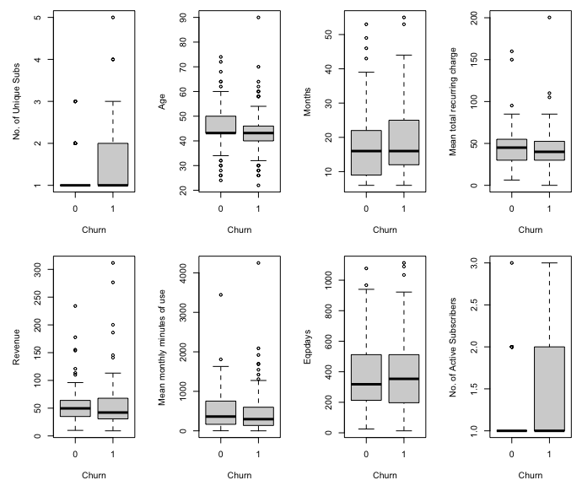
Appendix:
Relationships
By looking at the box plots, we can see that there are not any significant variation in the churn group vs. the non-churn group specifically for variables like Revenue, mean monthly minutes of use, months, mean monthly recurring charge. But if we still had to pick up the relationships between churn and other predicted variables, we can choose number of unique subscribers, number of active subscribers and age
Notes:
We cross-tabulated all categorical predicted variables with churn and constructed boxplots of all continuous variables with churn. We examined both the tabulations and the plots but there was not any significant variation in the churn group vs. the non-churn group.

Slide 20
APPENDIX: Features of Logistic Regression
Variable | Parameter Estimate | Meaning | Importance
Age of first household member (Age1) | -0.005 | For one unit change in the age of 1st household member, the churn rate decreases by 0.57% | LOW
Mean total recurring charge (Recchrge) | −0.005 | The relationship indicates that for every one-unit increase in the mean total recurring charge, the churn rate for customers decreases by 0.5% suggesting that higher frequency of recharges are associated with lower customer turnover. | LOW
Mean monthly revenue (Revenue) | 0.004 | For every one-unit increase in revenue, the churn rate for customers in a cellphone company increases by 0.4%, suggesting that higher revenue is associated with slightly higher churn rate. | LOW
Mean number of roaming calls (Roam) | 0.006 | For one unit change in the mean number of roaming calls, the churn rate increases by 0.6% | LOW
Percentage change in revenue (Changer) | 0.002 | For one unit change in the % change in revenues, the churn rate increases by 0.2% | LOW
Notes:
Please note: all features with low importance have been attached in the appendix for reference.

Slide 21
Thank You!

